Slide 1

Python Scripting with Network
Day 6

Slide 2

Agenda
Python API for Network Automation
Python Advanced Functions
Python Multithreading
Python Regular Expressions
REST API
JSON API parsing with Python

Slide 3
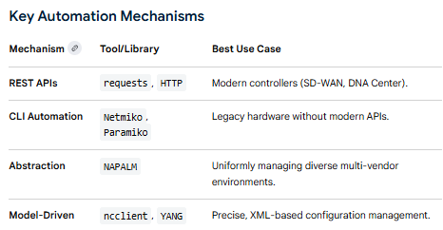
Python for Network Automation
Python has become the industry standard for network automation because it can interact with devices through multiple "APIs"—ranging from modern REST APIs to traditional CLI-based automation libraries.
While standard CLI scripting (using Paramiko) works, programmatic APIs like REST or RESTCONF are preferred because they return structured data (JSON/XML). This eliminates the need for complex text parsing with regular expressions and makes scripts more reliable across different software versions

Slide 4
Python Advanced Functions
Map: Applies a specific function to every item in an iterable (like a list) and returns an iterator.
Filter: Filters a sequence by testing each element against a function that returns a boolean (True/False).
Reduce: Part of the functools module, this function progressively reduces a sequence to a single value by applying a rolling computation (e.g., finding the sum or product of a list).
Zip: The zip() function combines multiple iterables into a single iterable of tuples. The zip() function stops when the shortest iterable is exhausted.
Enumerate - The enumerate() function adds a counter to an iterable and returns an iterable of tuples, where each tuple consists of the counter and the original element.

Slide 5
Python Multithreading
Python multithreading allows a program to run multiple tasks concurrently within a single process. It is primarily used to improve the efficiency of I/O-bound tasks (like downloading files or web scraping), where the program spends a lot of time waiting for external resources.
Concurrency, not true Parallelism: Because of the GIL, multithreading doesn't speed up CPU-heavy math (CPU-bound tasks). Instead, it "switches" between threads very fast to hide latency during waiting periods.
Shared Memory: Unlike separate processes, all threads in one program share the same memory space, making it easy to share data but requiring Locks to prevent data corruption.
Modern Update: Newer versions like Python 3.13+ have introduced experimental "free-threaded" builds that can run without the GIL, allowing true parallel execution on multiple CPU cores.

Slide 6
Python Regular Expressions
In Python, regular expressions (regex) are handled through the built-in re module, which provides a powerful set of tools for searching, matching, and manipulating text strings based on specific patterns
re.search(): Scans through a string and returns a match object for the first location where the pattern is found.
re.match(): Checks for a match only at the beginning of the string.
re.findall(): Returns a list of all non-overlapping matches of a pattern in the string.
re.sub(): Replaces occurrences of a pattern with a specified replacement string.
re.split(): Splits a string into a list wherever the pattern matches.
re.compile(): Compiles a regex pattern into a reusable pattern object, which is more efficient if the pattern is used multiple times.

Slide 7
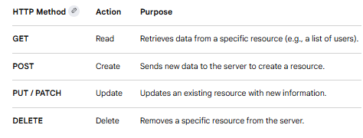
Overview of REST API
Python is one of the most popular languages for building and interacting with REST (Representational State Transfer) APIs. These APIs act as a standardized contract between different software systems, allowing them to exchange data—usually in JSON format—over HTTP.

Slide 8
JSON API for Python
Working with JSON in Python typically involves two main tasks: parsing data from an external API or building your own API that serves JSON.
json.loads(string): Decodes a JSON-formatted string into a Python dictionary or list.
json.dumps(obj): Encodes a Python object into a JSON-formatted string (useful for sending data to an API).
json.load(file) and json.dump(obj, file): Used for reading from or writing directly to .json files

Slide 9
Wrap Up
Python Automation for Network engineering
Python Network Libraries
Python Modules
Python Lambda Functions

